Slide 1

COAP/COSSAP: Category 2 and 4
Subgrantee Workshop
Project Period: September 15, 2020 – September 14, 2022

Slide 2
AGENDA - TOPICS
Introductions
Overview of COAP/COSSAP
Federal Special Conditions
DFA-IGS General Terms and Grant Conditions
Require Prior Approval from DFA-IGS
Excel Subrecipient COAP Workbook (PDF)
Monthly Reimbursement Requests-Process
  Final Invoice/Due Date
Budget Modification Requests/Submissions
  Final Budget Revision/Due Date
Reporting/Tracking
Important Dates
Peer-to-Peer Learning (Subgrantee Meetings)
  Purpose
Evaluation of COAP/COSSAP Projects
  Purpose
Q&A

Slide 3
OVERVIEW OF COAP/COSSAP
  Federal Awards 2018, 2019, and 2021
  Comprehensive Statewide Strategic Plan (Category 4)
  Statewide COAP/COSSAP Logic Model
  COAP 4 and COAP 2 Requirements (Focus)

Slide 4
COAP/COSSAP Strategic Priorities | COAP/COSSAP Overall Goals
Priority 1: Stigma | Goal 1: Reduce stigma associated with persons with substance use disorders through law enforcement and community education efforts.
Priority 2: Support and Recovery Services | Goal 2: Increase substance use disorder treatment support for justice-involved persons and their families.
Priority 3: Overdose Response | Goal 3: Improve overdose investigation response by law enforcement agency personnel.
Priority 4: Law Enforcement Capacity Building | Goal 4: Increase awareness about the opioid crisis and law enforcement/community strategies through building capacity and providing education.
Priority 5: Data Collection | Goal 5: Enhance and/or build linkages across state and local level data collection systems.

Slide 5
Category 4 and 2 Program Requirements:
The project must plan to serve a high need area (demonstrated in Problem Statement).
The Applicant must have a commitment to a project planning period for developing a Grant Action Plan. (Community/Project Logic Model)
The Applicant must have a commitment to attend COAP Trainings/Webinars (Subgrant Administration, COAP Resource Training, etc.).
The Applicant must have a commitment to establishing a diverse workgroup/taskforce for opioid, stimulant, and substance misuse (including various community sectors). Category 4 Only
The Applicant must be available to participate in cross-site training with the Department of Justice/Bureau of Justice Association (BJA) as well as peer-to-peer learning with other COAP subrecipients locally and nationally.

Slide 6
Continued….
The Applicant must have a commitment to focus on addressing fatal and non-fatal overdose incidences in its jurisdiction.
The project must have a focus on leading people to recovery and providing support to families and victims of fatal and non-fatal incidences of overdose.
The Applicant must report overdose incidence(s) to ODMAP.
Applicants are highly recommended to contract and/or collaborate with a Peer Recovery Specialist(s) for family and victim support services. (Required for Category 2 projects) Respond when incident occurs and provide prevention, education, and awareness-Category 4

Slide 7
Category 2 Program Requirements:
Hire full-time investigator (for field operations of fatal/non-fatal overdose incidents investigations)
Hire/Contract a Peer Recovery Specialist(s) for family and victim support services (Respond when incident occurs with investigation Primary/ Secondary is prevention/education/awareness)
Use the Tru-Narc analyzer that will be provided by the State Drug Director Office and DFA-IGS and report data obtained as requested

Slide 8
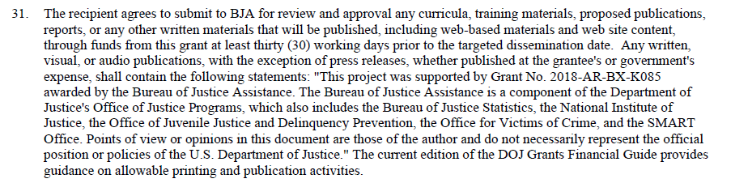
NOTED FEDERAL SPECIAL CONDITIONS
#34, #35, #42, #47 (COAP 2019)

Slide 9
GENERAL TERMS AND GRANT CONDITIONS
  SEE DOCUMENT – General Terms and Grant Conditions
  #13 - #20

Slide 10
PRIOR APPROVALS
NEEDED
  Community Outreach/Awareness
  Out of State Travel/Trainings
  Unnamed Equipment Items or Items not approved
  Budget Modifications

Slide 11
COAP
Workbooks
COAP Workbooks
Instructions, Subgrant Information, Approved Budgets
Budget Modifications
  Budget Revision Worksheet and Budget Narrative Forms
Invoices/Reimbursement Forms
Inventory Report, Financial Report, Year End Report Narrative (Close-Out Documents)

Slide 12
See COAP Workbook

Slide 13
INVOICING/PROCESSING
  Reimbursement Submissions/Due Date – 15th of each month
  Invoice Documentation
  Authorized Official/Acting Authorized Official (Signature on Reimbursements/Invoices)
  Indirect Costs (how to request if in approved budget)
  Invoices Submitted to IGS inbox igs.jag@dfa.Arkansas.gov
  Final Invoices/Due Date – 10/15/22

Slide 14

MONTHLY INVOICE PROCESSING:
Invoice submissions are due by the 15th of each month.
ELECTRONIC SUBMISSION PACKET:
  Copy of (Excel) Workbook Invoice
  Copy of signed and scanned Invoice (signed by Authorized/Acting Authorized Official)
  Completed Index with Supporting Documentation with all pages numbered:
    Signed Timesheets, Paystubs, Payroll Registers, General Ledgers
    Paid Invoices, Paid Receipts, Monthly Statements/Invoices, Credit Card Statements
    Cancelled Checks, Bank Statements

Slide 15
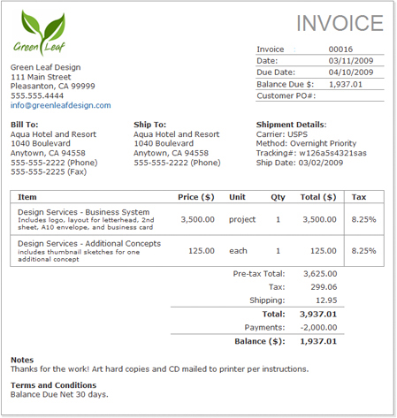
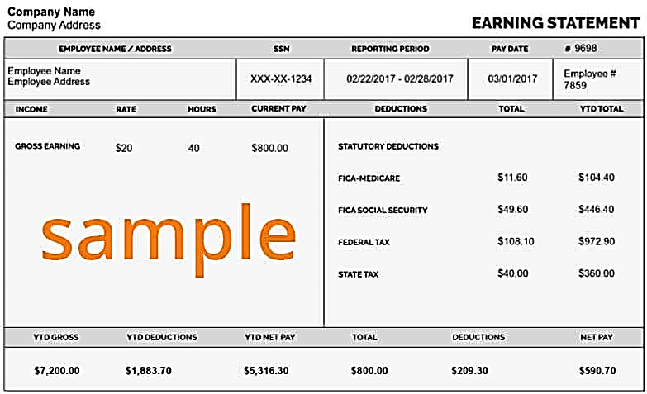

Slide 16
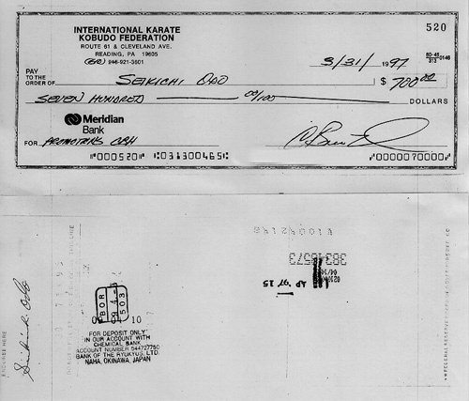
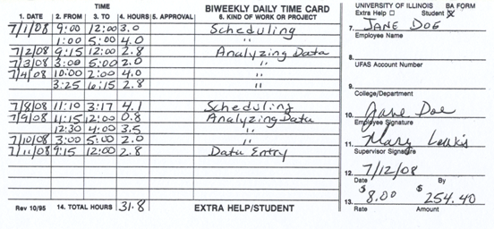

Slide 17

Salaries
Required Documentation
Copy of Check/Pay Stub/Payroll Register (this reflects payment, employee deductions as well as employer)
Cancelled Checks/Bank Statements-Direct Deposits (reflects proof of payment)
Timesheet(s) for each pay period requested:
  Must be completed for each employee
  Must reflect dates worked
  Must reflect dates within the project period
  Must be signed by the employee and the supervisor
  *Contracted labor also requires the above documentation

Slide 18

Mandated Benefits
Required Documentation
FICA (7.65%)**
  E-file Online Statements
  Cancelled Check/Bank Statement (Proof of Payment)
STATE UNEMPLOYMENT (Approved Rate In Budget)
  Completed Standard Form
  Cancelled Check/Bank Statement (Proof of Payment)
WORKER’S COMPENSATION (Approved Rate In Budget)
  Cancelled Check/Bank Statement (Proof of Payment)
** Mandated Benefits Supporting Documentation is not required but recommended for processing an invoice. Supporting Documentation for these expenditures must be on file and required when site visits are conducted. Mandated Benefits will be reimbursed on salaries requested and the percentage rate approved.

Slide 19
Employer Benefits
Required Documentation
HEALTH INSURANCE (Approved Amount In Budget)
  Invoice/Statement from Health Insurance Provider (indicating employee name and amount)
  Cancelled Check/Bank Statement (Proof of Payment)
  General Ledger
RETIREMENT (Approved Rate In Budget)
  Completed Standard Form (Indicating Employee Contribution and Employer Contribution)
  Or E-File Online Statement (Indicating Employee Contribution and Employer Contribution)
  Cancelled Check/Bank Statement (Proof of Payment)
  General Ledger

Slide 20




Maintenance and Operations
Required Documentation
Maintenance and Operations include Communications, Postage, General Office Supplies, Vehicle Maintenance\fuel, Insurance, etc.
  Statements/Invoices w/ itemized purchases indicating dates of services/dates of purchase as well as the amounts
  Paid Receipts, Credit Card Statements
  Cancelled Checks/Bank Statements (Proof of Payment)
  Please Note: According the DOJ Financial Guidance – Can Not Reimburse Employees other than travel expenses

Slide 21
Professional Services
Required Documentation
Professional Services include Bookkeeping\Accounting Services, Vehicle Lease, Storage Building Rental, Office Space Lease\Rent, Contract Labor Etc.
  Monthly Invoice/Statement from the Vendor
  Lease agreement/contract on file with DFA-IGS indicating the monthly scheduled payment
  Contract labor – monthly statement from vendor on letterhead with supporting documentation
  Cancelled checks paid to vendor/contract labor as proof of payment

Slide 22
Travel, Training, and Equipment
Required Documentation
Travel and Training
  Mileage Logs (Detailed)
  Transportation-Flights/Rental, etc.
  Lodging/Hotel Receipts
  Travel Requisitions-Per Diems
  Travel Reimbursement Forms
  Need DFA-IGS Approval (Out of State) – Conference/Training Information
Equipment ($1500+)
  Need DFA-IGS Approval
  Follow agency policy for purchasing.
  Submit purchasing packet to DFA-IGS
  Purchased Item Listed on Inventory Form

Slide 23


Please Remember…
When an item is not approved because of lack of supporting documentation, you can resubmit on the next invoice with the proper documentation.
Number each page of the reimbursement request. The Index should outline all supporting documentation with page numbers.
Make sure all documents are legible.
Invoice “To” and “From” dates must reflect the dates of service in the request.
Submit only documentation that supports requested amounts for each line item/category.
Credit card Statements are proof of purchases, not proof of payment. Record of payment must also be submitted.
A cancelled check must reflect that the check has cleared (front and back of check is required if bank statement not available).
According the DOJ Financial Guidance – Can Not Reimburse Employees other than travel expenses

Slide 24
See Budget Modification/Workbook

Slide 25
Budget Modification Requests and Submission
Budget Revision Worksheet
Budget Revision Narrative
Approved Revised Budget
**Adding new line items after budget approval or during the project period is not allowable.

Slide 26
COAP/COSSAP
Reporting/
Tracking
PMT – Federal System
-PURPOSE-
ON-LINE
SUBMISSION QUARTERLY
ODMAP
www.odmap.org
-PURPOSE-
ON-LINE
SUBMISSION
Tracking of Activities (For Evaluation)
-PURPOSE-
ON-LINE SUBMISSION

Slide 27
IMPORTANT DATES
Monthly Invoices** Due – 15th of Each Month
Final Invoices Due – October 15, 2022
Close-Out Documents Due – October 30, 2022
Final Budget Modifications Due – August 15, 2022
PMT Reporting (Due Quarterly) – January 15th, July 15th, October 15th
Tracking of Activities (On-Line Reporting Monthly) Due - 10th of Each Month (or can be entered daily/weekly or as activities occur)
ODMAP Reporting – When Incidents Occur
DUNS Expiration Date**

Slide 28
PEER TO PEER MEETINGS
(OFFICE OF THE STATE DRUG DIRECTOR)

Slide 29
COAP/COSSAP
EVALUATION
(CARES EVALUATORS)
Introductions
Statewide COAP/COSSAP Logic Model
Subrecipient Logic Models
Online Tracking Forms (Activities)

Slide 30
COAP/COSSAP ASSIGNED GRANTS ANALYST
Tanya Patton, Grants Analyst
  Central AR DTF-6th JD
  Lonoke County
  City of Hot Springs
  Izard County-2
  Johnson County
  Jefferson County-2
Tammy Wiggins, Grants Analyst
  Garland County
  Jefferson County-4
  City of Searcy-PD
  Sevier County
Tiffany Evans, Grants Analyst
  City of Fort Smith
  City of Marmaduke
  Scott County
  Izard County-4
  Fulton County

Slide 31

Contact
Information
  DFA-IGS Staff:
  Kenya Buffington, Program Manager
  kenya.Buffington@dfa.Arkansas.gov
  501-416-3741
  Tanya Patton, Grants Analyst
  tanya.patton@dfa.Arkansas.govv
  501-683-1743
  Tiffany Evans, Grants Analyst
  tiffany.evans@dfa.Arkansas.gov
  501-682-5022
  Tammy Wiggins, Grants Analyst
  tammy.Wiggins@dfa.Arkansas.gov
  501-682-4798
  Kathleen Kenney, Fiscal Support Specialist
  kathleen.kenney@dfa.Arkansas.gov
  501-682-5254
Email: IGS.JAG@dfa.arkansas.gov
Phone: 501-682-1074
Office of State Drug Director Staff:
Sharron Mims, Program Manager
Sharron.mims@asp.arkansas.gov
501-618-8447

