Slide 1

 | STATE OF ARKANSAS Department of Finance and Administration | Office of Intergovernmental Services 1515 West Seventh Street, Suite 400 Post Office Box 8031 Little Rock, Arkansas, 72203-8031 Phone: (501) 682-1074 Fax: (501) 682-5206 https://www.dfa.arkansas.gov/intergovernmental-services
DEATH IN CUSTODY STATE IMPLEMENTATION PLAN
1

Slide 2
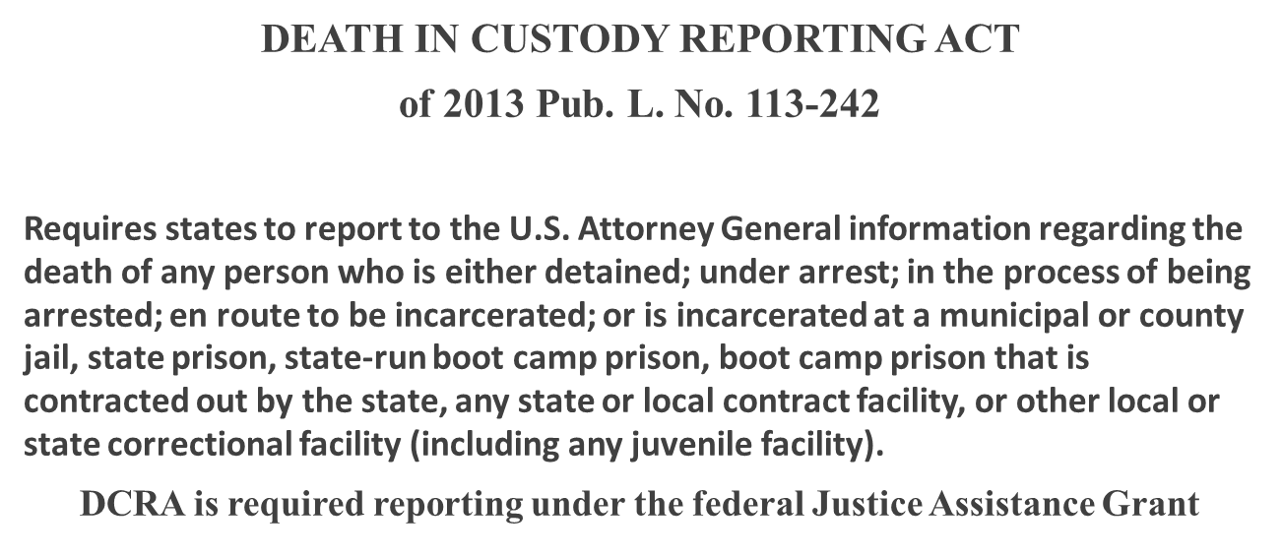

Slide 4
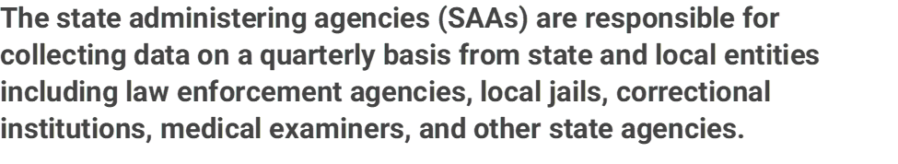

State Administering Agency
Arkansas Department of Finance and Administration is the (SAA) and collects reporting data from ACIC and submit reports to BJA.

Slide 5
SAA & Reporting Entities
Arkansas Department of Finance and Administration (DFA) as the SAA is responsible for submission of the Death in Custody Report (DCRA) to BJA.
Each quarter, the SAA received reports from ACIC which is then submitted to the federal agency.
In recent quarters, BJA has requested revisions to the data submitted. ACIC is working on revising the data.
The DCRA report is submitted quarterly along with other quarterly reports in the federal reporting system.

Slide 6

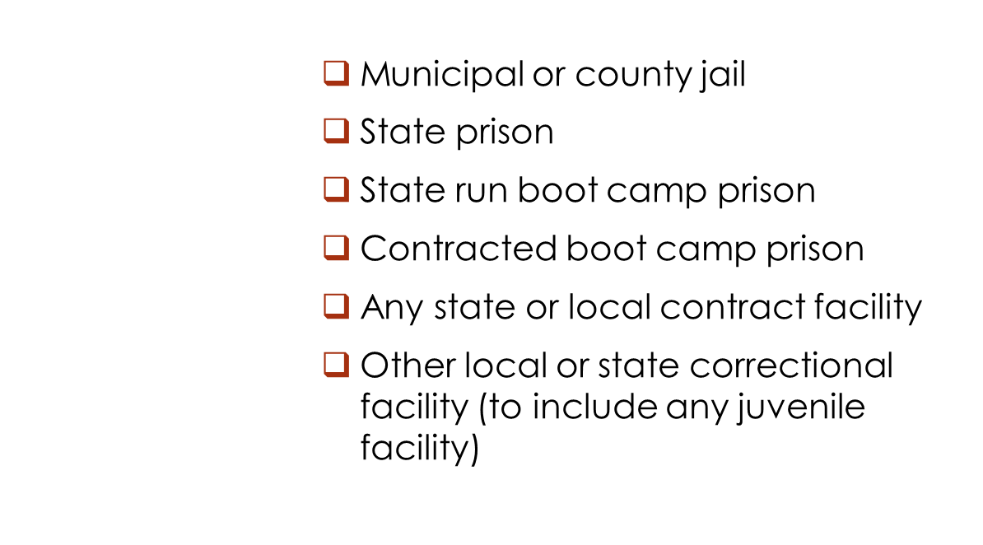


Slide 7

In addition to quarterly reporting, BJA now requires a State Implementation Plan beginning in FFY23. This plan is mandatory to under the JAG federal grant.
The link to the training on DCRA State Implementation Plan is located at: Death in Custody Reporting Act (DCRA) State Implementation Plan Training (youtube.com)
The SAA must coordinate with all required stakeholders to develop a plan for collecting and reporting date to BJA.
DCRA TTA Center (JRSA) is available to provide assistance if needed
BJA and DCRA TTA Center (JRSA) reviews and approves the submitted Plan.
SAA will arrange training with JRSA if needed.

Slide 8
FEDERAL GRANT AFFECTED:
2023 JAG
Until the Implementation Plan is submitted, access to funding under 2023 JAG grant is placed on hold. Plan must be at least minimally sufficient in order for the hold on funding to be released.
Approved plans will be made public.

Slide 9
State Implementation Plan for DCRA

Slide 10
State Implementation Plan for DCRA (continued)
Expectations:
Starting where you are today and move the needle forward. Explain outreach strategies to get everyone on board. Understand and document challenges. Describe state statute in comparison to federal law. Engage with state membership organizations for police sheriff/jails and corrections to help facilitate reporting.
Plan Updates:
Plan changes to be submitted annually and must show progress over time.

Slide 11
State Submit Implementation Plan
BJA Review
JRSA Review
The BJA-JAG teams reviews state plan for minimum requirements
Ensure plan addresses all required criteria
Plan does not have to be perfect
Feedback
After BJA-JAG team reviews, plans are sent to JRSA for an in-depth review
JRSA will conduct outreach to SAA’s regarding their plan and provide feedback/TTA as needed

Slide 12
Target timeline
Complete the Draft of the implementation plan and submit by February 29
1
Receive feedback/ request TTA if needed/revise and resubmit by
March 31
2
Obtain final approval by
April 30
3

Slide 13
QUARTERLY DEATH IN CUSTODY REPORTING

Slide 14
QUARTERLY DEATH IN CUSTODY REPORTNG DATA
Provide the following decedent information. If you have multiple deaths in custody, report them one at a time.
A. Name: ____________________
B. Gender
1. Male
2. Female
3. Other gender identity: ____________________
C. Race (Select all that apply)
1. American Indian or Alaska Native
2. Asian
3. Black or African American
4. Native Hawaiian or other Pacific Islander
5. White
6. Unknown
D. Ethnicity
1. Hispanic, Latino, or Spanish origin
2. Not of Hispanic, Latino or Spanish origin
3. Unknown
E. Birth year (YYYY) (If unknown, enter “9999”): ___________________
1. Was there at least one reportable death in your state during the reporting period? A reportable death refers to the death
of an individual who was detained, arrested, enroute to incarceration, or incarcerated in a state or local facility or boot
camp prison.
A. Yes
B. No (If No, this marks the conclusion of the module)
C. If Yes, provide the number of reportable deaths in your state during the reporting period:_______________
12

Slide 15
QUARTERLY DEATH IN CUSTODY REPORTNG DATA (continued)
3. List the following information regarding the decedent’s death.
A. Date of death (MM-DD-YYYY): _________________
B. Time of death (24-hour clock): _________________
C. Location of death
1. Location name (if applicable). This could be the name of a facility, place of business, or other designation for the
location of death: ________________
2. Street address: _________________
3. City: _________________
4. State (postal abbreviation): _________________
5. Zip code: _________________
D. If the event causing the death occurred in any of the following facilities, indicate the appropriate facility. If the event
causing the death did not occur in one of the following facilities, select “none of the above.”
1. Municipal or county jail
2. State prison
3. State run boot camp prison
  4. Contracted boot camp prison
5. Any state or local contract facility
6. Other local or state correctional facility (to include any juvenile facility)
  7. None of the above
4. List the name of the department or agency that detained, arrested, or was in
the process of arresting the deceased.
A. Agency name: ___________________
13

Slide 16
QUARTERLY DEATH IN CUSTODY REPORTNG DATA (continued)
5. Indicate the manner of death. Select only one.
A. Execution (i.e., capital punishment)
B. Accident
C. Death attributed to use of force by a law enforcement or corrections officer
D. Homicide (e.g., an incident between two or more incarcerated individuals resulting in death)
E. Natural causes
F. Suicide
G. Unavailable, investigation pending
If Yes, report the agency conducting the investigation and an approximate end date. When the investigation has concluded, contact State of Arkansas Department of Finance and Administration to update this report. ___________________
H. Other, explain: ____________________
Provide a brief description of the circumstances leading to the death (e.g., details surrounding an event that may have led to the death, the number and affiliation of any parties involved in the incident, the location and characteristics of the incident, other context related to the death, etc.). ___________
Examples of brief circumstances surrounding a decedent’s death:
Provide the number of individuals involved in any altercations preceding death (e.g., number of inmates or law enforcement officers on scene).
Provide a more specific manner of death (e.g., end-stage liver disease, stab wounds from
an altercation, asphyxiation due to being placed in a prone position while restrained).
Provide a general time of day that the death occurred (e.g., morning, afternoon; evening).
Provide the location of the decedent (e.g., jail cell, scene of arrest, medical facility).
For deaths occurring during the process of arrest – Arrest-Related Deaths (ARDs) – BJA requests several additional details be provided in the brief circumstances, including: why initial contact was made with the decedent, if the decedent was armed, if the decedent was resisting arrest, and if life-saving measures were administered.

Slide 17
LINKS TO DCRA RESOURCES
RESOURCES [FAQ, DCRA Performance Measures, Federal Law]
Death in Custody Reporting Act (ojp.gov)
Death in Custody Act Performance Measures Questionnaire (ojp.gov)
uscode.house.gov/statviewer.htm?volume=128&page=2860

Slide 18

ANY QUESTION’S OR CONCERN’S, PLEASE CONTACT DFA Intergovernmental SERVICES
doris smith, administrator AT (501) 682-5242

