Slide 1
TECHNICAL ASSISTANCE WORKSHOP
NEW EXECUTIVE DIRECTOR TRAINING
May 21, 2024

Slide 2


Slide 3
Purpose of Training
To assist each subgrant organization in effectively utilizing their federal subgrant award by discussing the following topics:
  Budget
  Reimbursement Request:
  Reporting:
    Goals & Objectives
    Year-End Report
    Performance Report
    Subgrant Award Report (SAR)
  On-Site Monitoring;
  IGS Connect
  SAM.gov

Slide 4
VJA Staff Contact Information
Brian Lawson 501-682-5266 Program Manager
Brian.lawson@dfa.arkansas.gov
Margaret Pace 501-682-5021 Grants Coordinator
Margaret.pace@dfa.arkansas.gov
Harold Clayton 501-682-4723 Grants Coordinator
Harold.clayton@dfa.arkansas.gov
Jonathon Barriere 501-682-5150 Grants Analyst
Jonathon.Barriere@dfa.arkansas.gov
Sandra Johnson 501-682-5244 Grants Analyst
Sandra.Johnson@dfa.arkansas.gov

Slide 5

IGS WEBSITE
https://www.dfa.arkansas.gov/intergovernmental-services/grant-programs/request-for-proposals

Slide 6
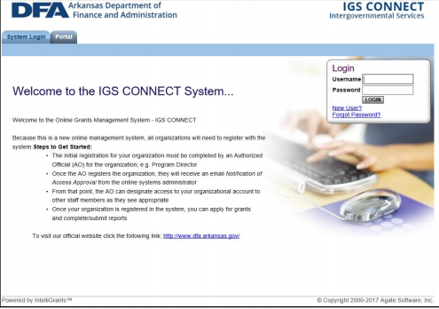
IGS Connect
To access IGS Connect, the grantee (Authorized Official or Acting Authorized Official) must have an assigned login consisting of a username and password. There are two ways for a grantee to obtain a login:
  Register as the initial Authorized Official of a new organization within IGS Connect, or
  Being granted an Acting Authorized Official account by an established Authorized Official for a pre-existing organization within IGS Connect.
An organization’s authorized/highest ranking official (AO) will need to register with IGS Connect using the new user link found on the home page (A confirmation e-mail will be sent to the provided e-mail address once the request is approved).
After an organization is granted access to IGS Connect, the Authorized Official can grant access to additional users from their organization under the Acting Authorized (AAO) Role.

Slide 7
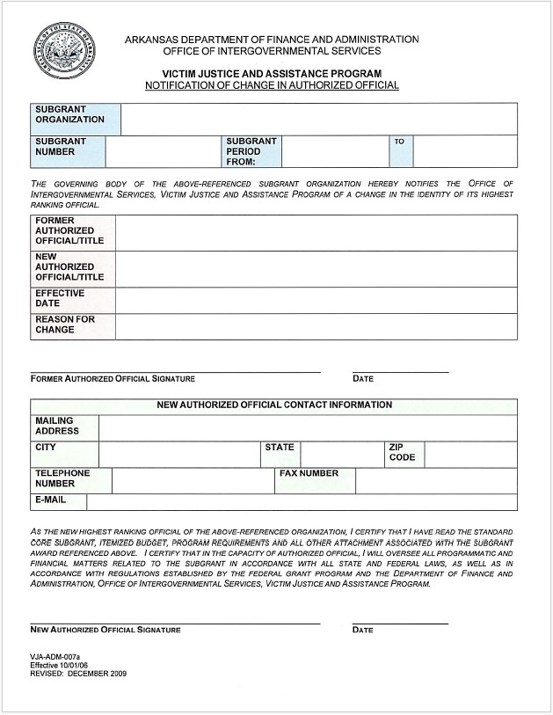
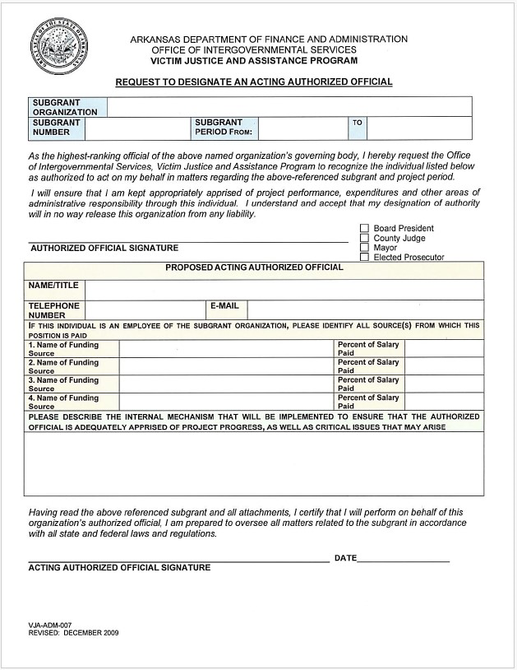
AUTHORIZED OFFICIAL & ACTING AUTHORIZED OFFICIAL

Slide 8
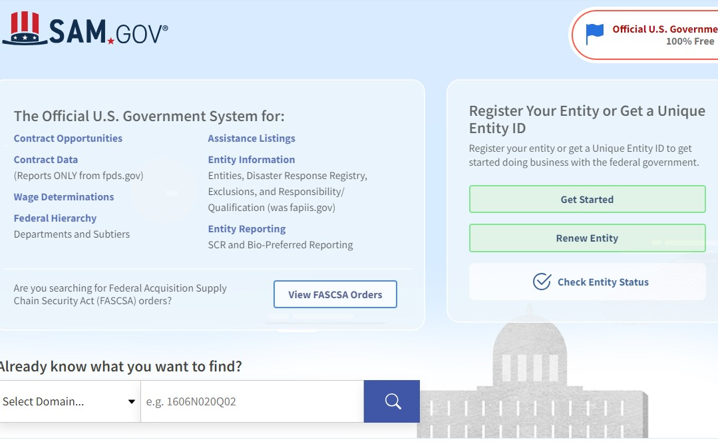
SAM.gov
Every organization is required to register with SAM.gov annually.
Failure to do so will prohibit organizations to submit Reimbursement Requests, Performance Reports, Year-End Reports.
Every organization is required to notify his/her Grant Analyst or Grant Coordinator when their SAM.gov has been updated.
Registering with SAM.GOV is a FREE SERVICE.

Slide 9
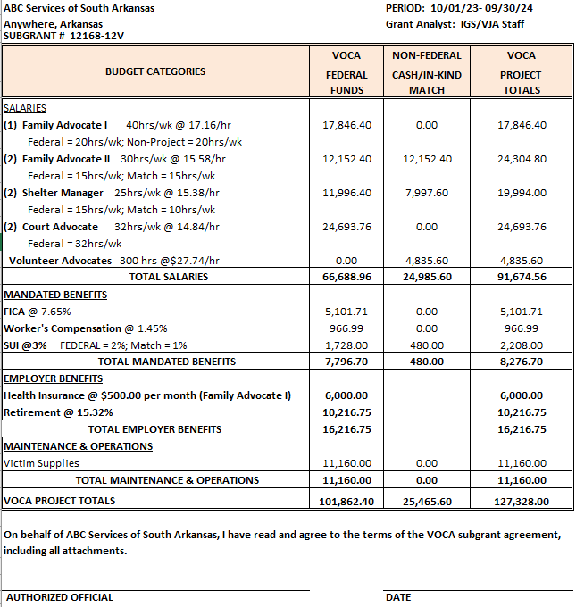
BUDGET

Slide 10
BUDGET
Salary Information: Include hourly rate of pay, hours devoted to the project (Federal Hours, Non-Project Hours, and Match Hours) Ex. hourly Rate X hours on project X 52 weeks.
Mandated Benefits: Includes FICA, Worker’s Compensation, & State Unemployment Insurance (SUI).
  FICA: 7.65%
  Worker’s Compensation: maximum rate is 5%
  SUI: maximum rate is 3% of the first $7,000 of salary
  Employer Provided Benefits
    Health Insurance: maximum allowable amount for federal funds is $500/project staff member
    Retirement: maximum allowable rate is 15.32%
  Maintenance & Operation
    Training/Travel
    Rent
  Professional Service Contract
    Attorney
    Mental Health Provider

Slide 11
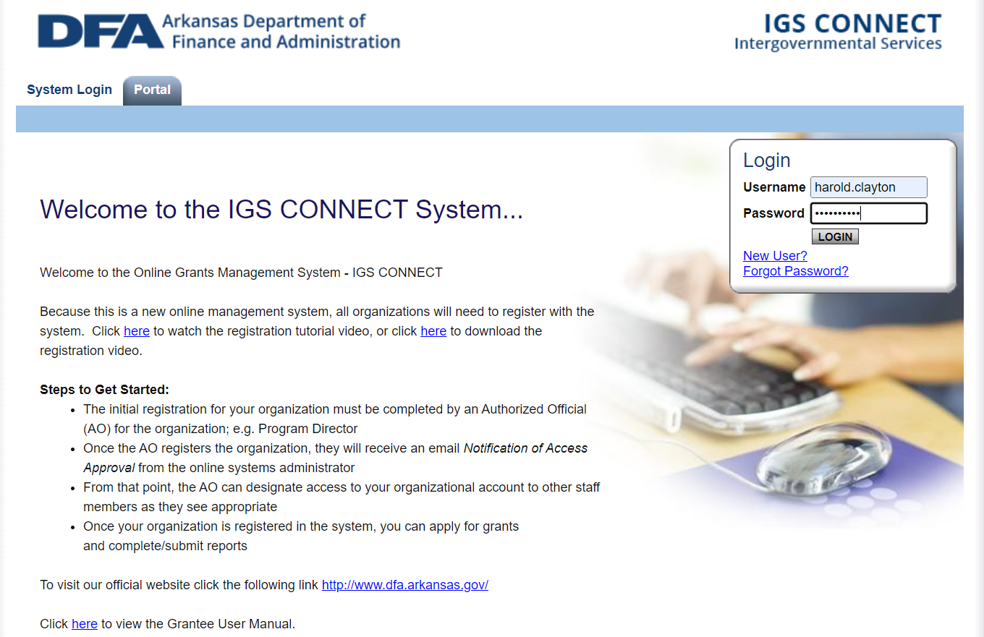
Reimbursement Request

Slide 12
Reimbursement Request
Reimbursement request are due the 15th of each month by 11:59 p.m. – No exceptions.
  If your report is late, you will not be able to request funds until the first of the next month and a Zero Invoice/Reimbursement will need to be completed for the missed month.
If you do not plan to request a reimbursement for the month, a zero request should be submitted for that month.
  For each section, you will enter the dates and check the box at the bottom of the page for a Zero Reimbursement.
Make sure you save your work often, watch for errors, and change the status to “Reimbursement Request Submitted”.
  After you have submitted your reimbursement request, you will receive an email telling you it has been submitted. If you do not receive an email, you have not submitted the report.
Notes:
All expenses for the missed month should be added to the current month’s request for one combined request.

Slide 13
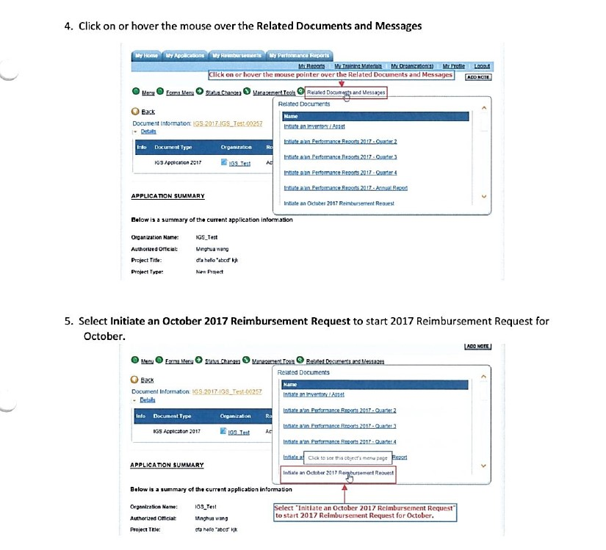
REIMBURSEMENT REQUEST

Slide 14
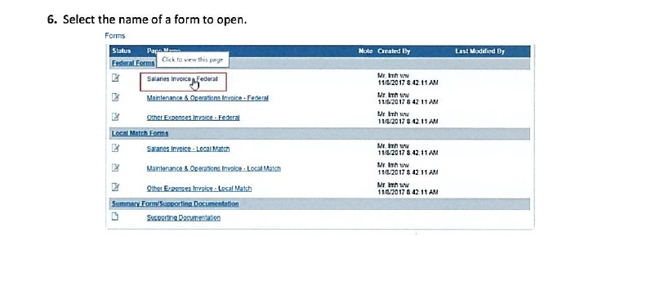
REIMBURSEMENT REQUEST

Slide 15
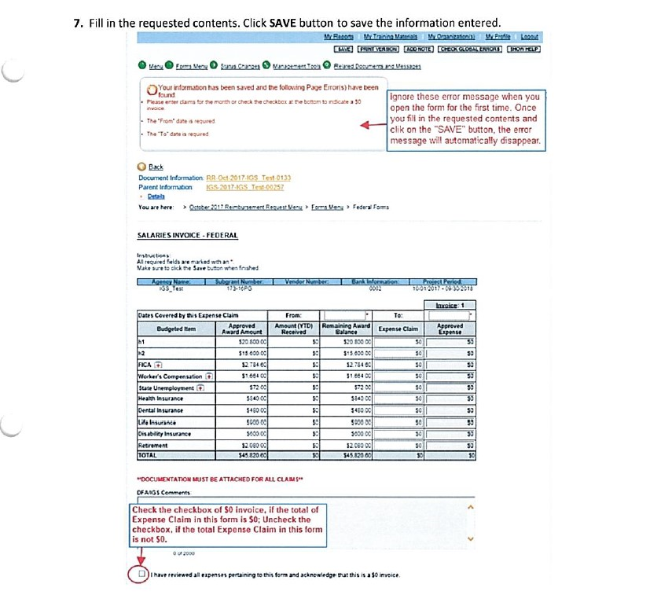
REIMBURSEMENT REQUEST

Slide 16
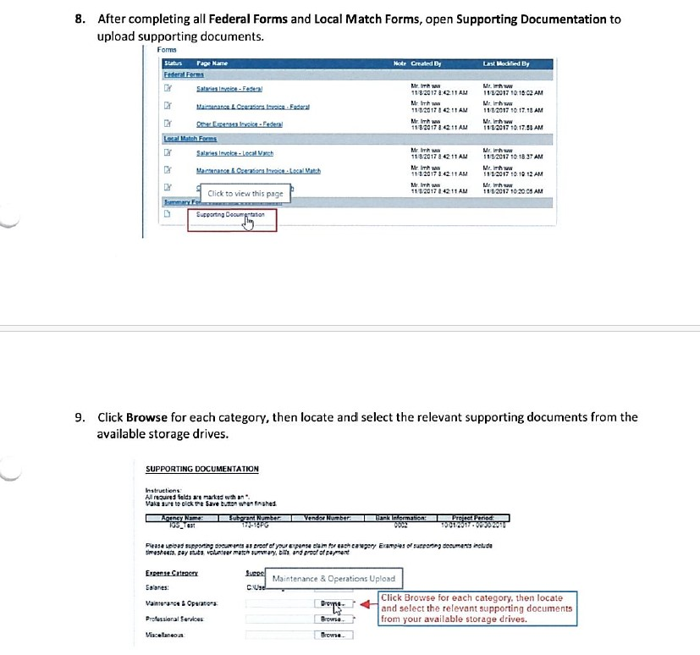
REIMBURSEMENT REQUEST

Slide 17
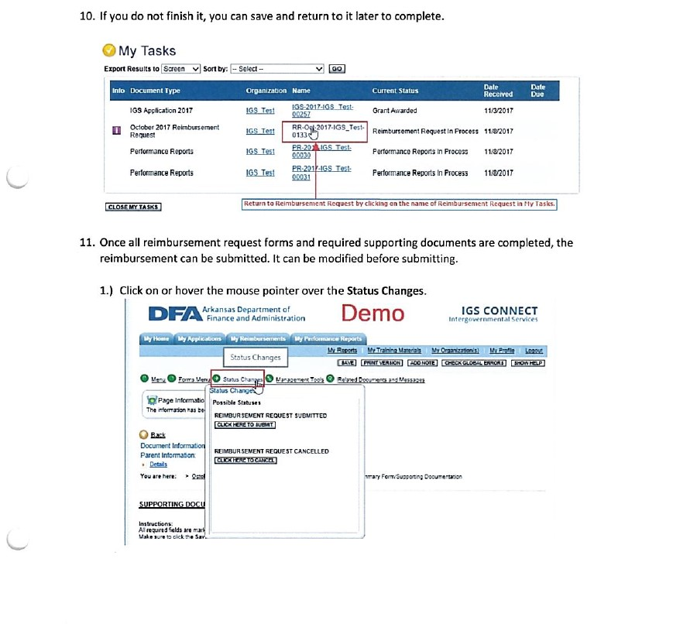
REIMBURSEMENT REQUEST

Slide 18
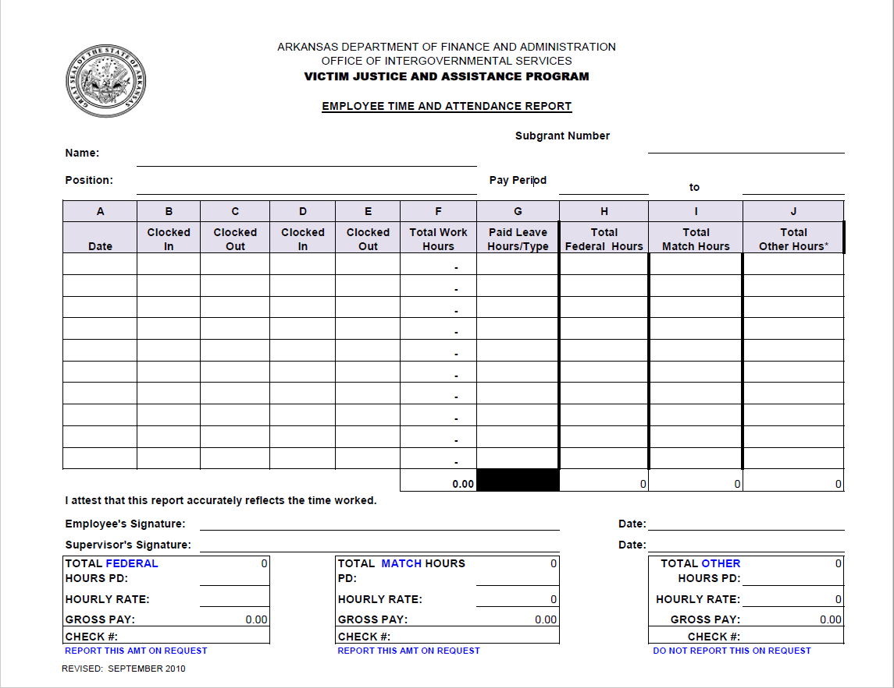
timesheets
Timesheets need to be submitted for all employees that are a part of the grant (Federal or Match).
Review timesheets each month to ensure correct information is being submitted.
  Pay period dates matches dates on employees' paystubs and matches pay period.
  Hours reported (Federal & Match)
  Correct Hourly Rate per budget
  Timesheets have been signed by employee and supervisor. Timesheets CANNOT BE HAND-WRITTEN except when signed by both “Employee” and “Supervisor”.
  Position title coincide with position listed within organization’s budget
  One pay period per timesheet.
  Weekly hours will be approved as budgeted.
Notes:
Timesheets should be typed and not handwritten for audit purposes.

Slide 19
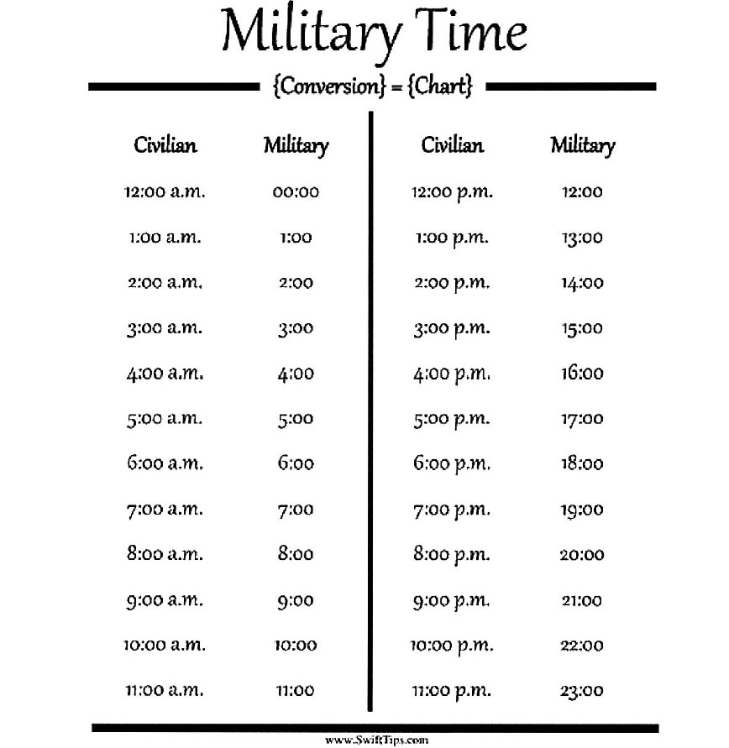
Timesheets (cont)
  All timesheets should reflect military time.
Notes:
Timesheets should be typed and not handwritten for audit purposes.

Slide 21
Match
Match reporting will commence October 1, 2024 – September 30, 2025, grant year.
VOCA - MATCH REQUIREMENT: For previously funded organizations, the organization must contribute no less than 20% of the federal portion of the project.
MATCH FORMULA: (Federal Funds Requested x 20)/80 = Required Match
STOP/VAWA – MATCH REQUIREMENT: The organization is required to provide a 28% match of the Federal portion of the project.
  MATCH FORMULA: (Federal Funds Requested x 28%) = Required Match
FVPSA – MATCH REQUIREMENT: The organization is required to provide no less than 20% of the Federal portion of the project.
MATCH FORMULA: (Federal Funds Requested x 20%) = Required Match

Slide 22
Match con’t
Match funds are restricted in the same manner as federal victim assistance funds and must be expended within the grant period.
Once an expense is designated as match for a federal grant, it cannot be used as match on another federal grant.
The purpose of matching contributions is to increase the amount of resources available to the projects supported by grant funds.
A few acceptable examples of in-kind match funds include office space, building depreciation value, employer benefits, donations for victims, staff salary, and volunteer time that has been equated to a dollar amount.

Slide 23
Volunteers
All VOCA recipients are required to utilize volunteers in their victim services program.
Volunteers must provide services that impact victims.
Volunteer hours are a good source of in-kind income that can be used to help fulfill the proposed project’s match requirement.
  DFA values volunteer hours at $27.74/hour.
  Neither Board members nor employees are eligible to be counted as volunteers.
Trouble finding volunteers?
  Local colleges
  Church groups
  Service Clubs (Rotary, Lions Club, Kiwanis Club)

Slide 24
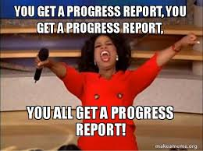
REPORTS
Notes:
Quarterly Performance & Goals and Objectives Reports due: Jan 15th, April 15th, July 15, and Oct 15th.

Slide 25
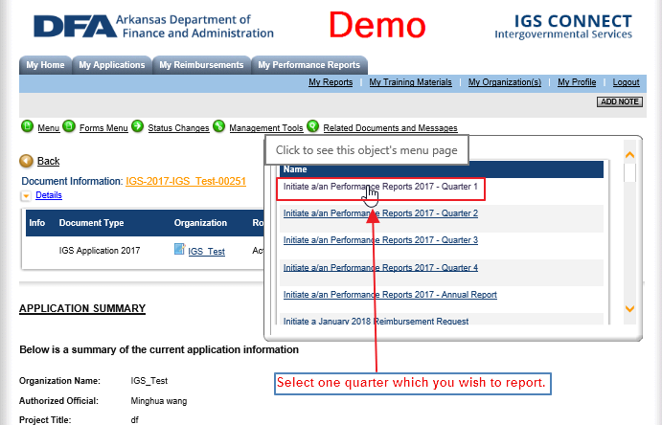
Initiating Performance Reports in IGS Connect

Slide 26
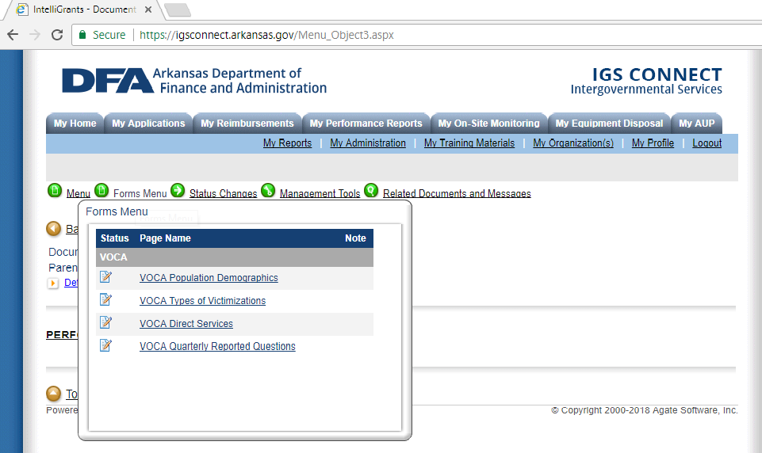
Performance Reports Sections
Click on forms menu and select the page to complete.
Return to form menu to complete each section.

Slide 27
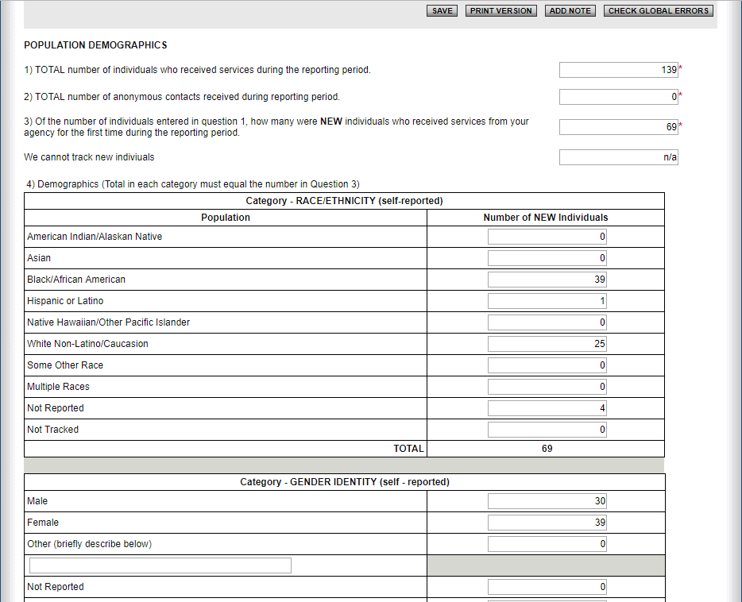
Performance Reports Demographics
Question 1 – Total number served for quarter.
Question 2 – Number of anonymous contacts for quarter.
Question 3 – Number of NEW clients served during the quarter
Questions 4 – Report number of NEW clients for each category (total will not be more than Question 3).

Slide 28
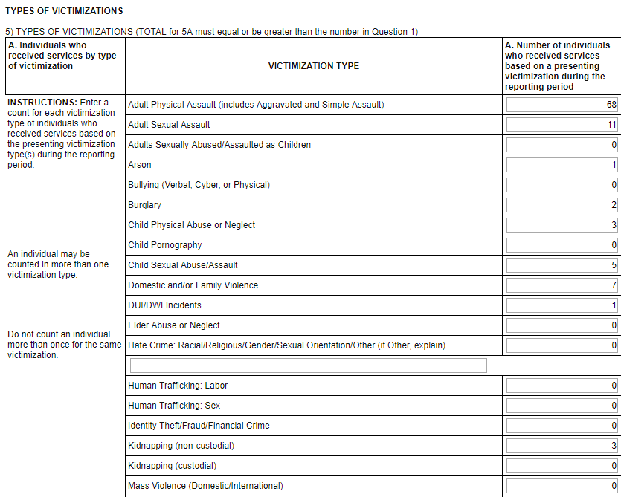
Performance Reports – Types of Victimization
Reported in this section are the specific types of Victimizations reported by each client seen during the quarter.
Report only the Victimization(s) and not the charge that was brought against the assailant.
Total number reported for question 5A must be greater than or equal to the response to Question 1.

Slide 29
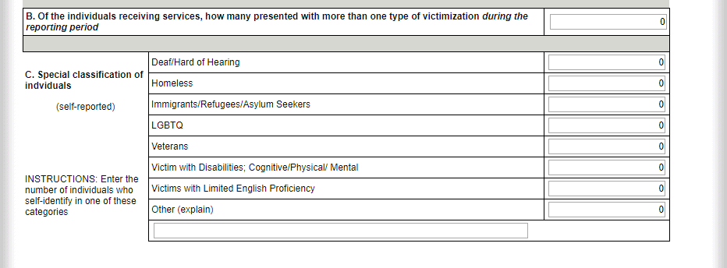
Performance Reports – Types of Victimizations
Question 5B – Report number of clients served that reported more than one victimization.
Questions 5C – Report number of clients served that self-reported being in one of the Special Classifications.

Slide 30
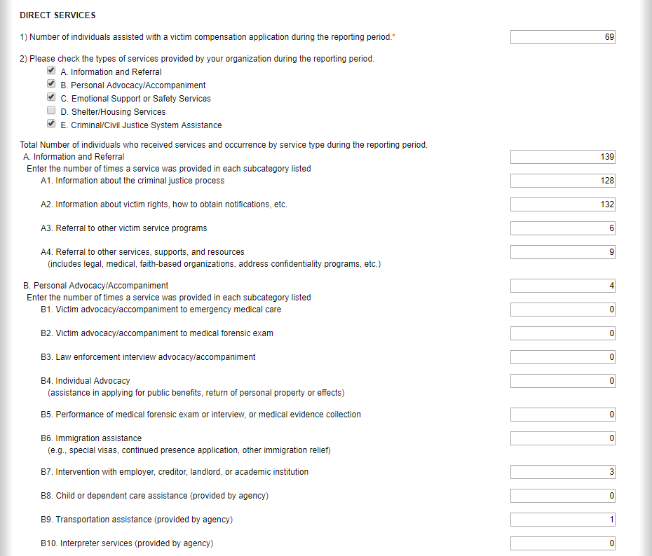
Performance Reports – Direct Services
Question 1 – Report number of clients assisted with victim compensation application.
Question 2 –Only select the services your provided during the reporting period.
  First reported number is total number of clients served (cannot be more than total number served for quarter).
  Sub-sections (A1, A2, …) is the total number of services provided during the quarter.

Slide 31
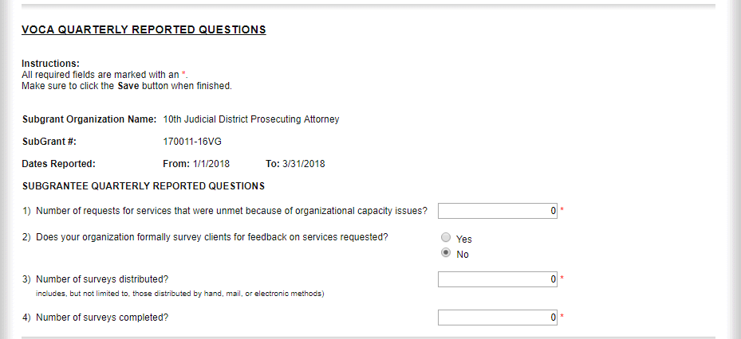
Performance Reports – Quarterly Reported Questions
Answer each question.

Slide 32
Completing Performance Reports
After each section has been completed, make sure you save that section.
To submit the completed report to your Grants Analyst, go to Status Change and press Performance Report Submitted.
  If you do not change the status, the Grant’s Analyst will not receive it.
  Reports will still be counted late even if it has been completed and the status not changed.
  Performance due dates – January 15th, April 15th, July 15th , and October 15th on or before 11:59p.m.

Slide 33
Program Goals & Objectives
Every program should have pre-established Goals & Objectives to help evaluate the program’s success.
  Goals are broad, big picture ideas or problems that your program wants to address.
  Objectives are the steps that your program will take to achieve the established goal.
    Objectives should be SMART
      S Specific
      M Measurable
      A Attainable
      R Relevant
      T Time-bound

Slide 34
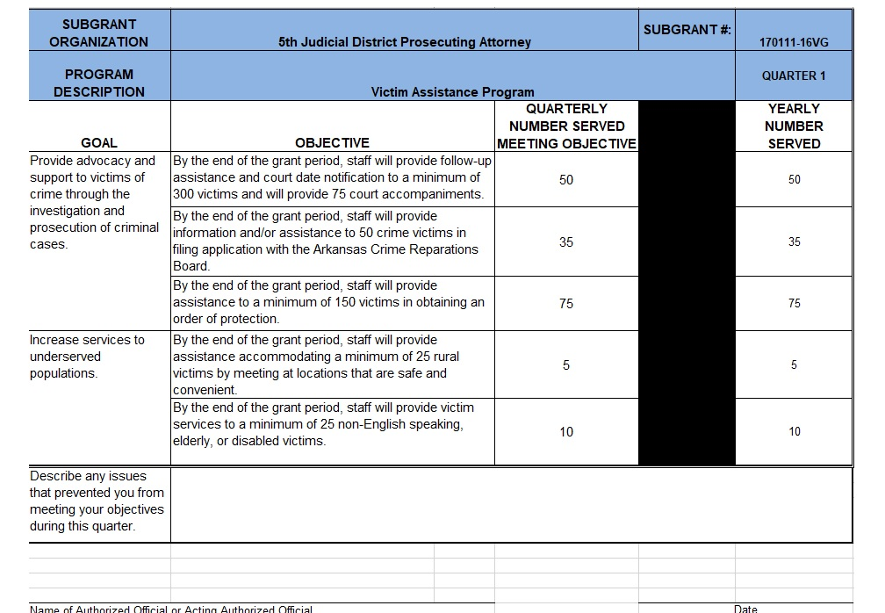
GoalS & Objectives Report
Goals & Objectives will already be provided for you.
Subgrantee will report the total number served for the quarter in the “Quarterly Number Served Meeting Objective” column.
“Yearly Number Served” column will auto-calculate each quarter and provide a total number served for the objective.
If an organization is not meeting its targeted number for the quarter, a brief explanation will need to be provided in the available space.
Report will need to be signed by either the organization’s Authorized Official or an Acting Authorized Official.
Report is to be emailed to your Grants Analyst.
Report due dates – January 15th, April 15th, July 15th, and October 15th on or before 11:59p.m.

Slide 35
Annual Reports
Annual Report will be a cumulation of all quarterly reports. No new data will need to be reported.
The Annual Report will be completed in IGS Connect
Annual Report will include a narrative section where each sub-grantee will have the opportunity to report on the work done by the organization over the past year.
  The narratives will need to be at least two paragraphs in length and highlight the work being done by the organization.
Annual Reports are due October 31st.

Slide 36
Annual inventory report
Due May 31st of each year.
Report any equipment purchased with grant funds.
Even if you have not purchased any equipment with funds, you are still required to submit a report.
Reports will be submitted via IGS Connect.

Slide 37
Subgrant Award Report (SAR)
Submitted twice per grant year (VOCA FUNDED RECEPIENTS ONLY).
  First Report will be due October 31st .
    Will give a picture of what you are going to do over the course of the grant year.
    Second (Ending) Report will be due October 31st.
      Will show what you have done over the past grant year.
Organizations will need to contact IGS/VJA staff to receive the report template.

Slide 38
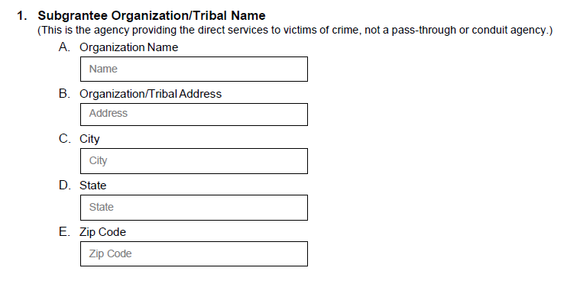
DIRECTIONS:
PLEASE ENTER THE INFORMAITON FOR THE AGENCY THAT IS PROVIDING SERVICES TO VICTIMS OF CRIME.

Slide 39
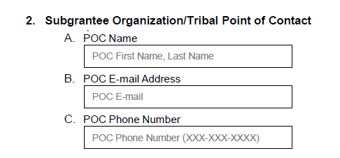
DIRECTIONS:
PLEASE ENTER THE POINT OF COTNACT FOR THE AWARD INTO THE BLANK BELOW.

Slide 40
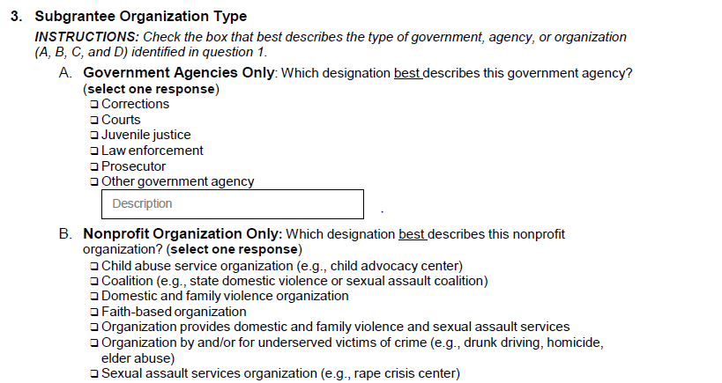
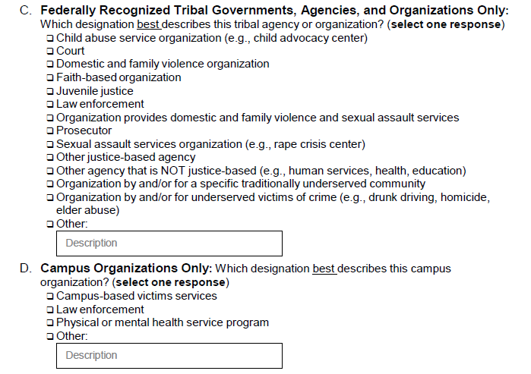

DIRECTIONS:
MAKE YOUR SELECTION OF A, B, C, OR D. WHICHEVER BEST DESCRIBES YOUR ORGANIZATION (ONLY CHOOSE ONE). ONCE THAT SELECTION IS MADE THERE WILL BE ANOTHER SET OF CHOICES BELOW. YOU CAN ONLY SELECT ONE OF THESE AS WELL.

Slide 41
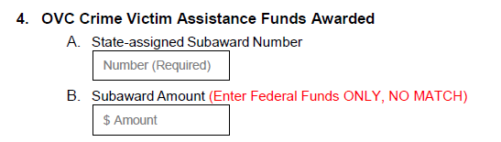
Directions:
A. Here is where the Subgrant Award Number will be filled in. The number is located on the Award DOCUMENT.
B. This is the Subaward Amount will be filled in. (Do not add match this number is just the Federal Funds that are being awarded you your organization.)

Slide 42
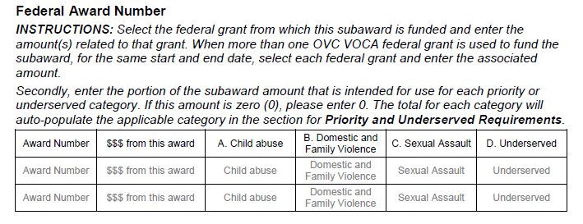
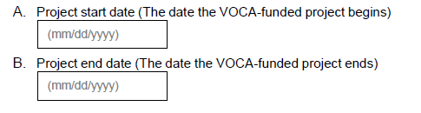
Directions:
Award Number- Located on the Award Packet.
$$$ from this Award- Will be the same and the number in above blank B.
A Child Abuse- Will be a % of the amount in $$$ from this Award
B Domestic and Family Violence- Will be a % of the amount in $$$ from this Award
C Sexual Assault- Will be a % of the amount in $$$ from this Award
D Underserved- Will be a % of the amount in $$$ from this Award
NOTE: There are four Service Categories for VOCA. They are: Child Abuse, Domestic Violence, Sexual Assault, and Underserved
Directions
A. Project start date Will be located on the award packet.
B. Project end date Will be located on the award packet.

Slide 43
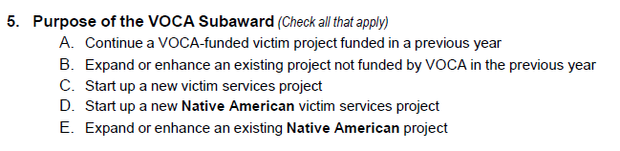
Directions
There are five different options A, B, C, D, and E. Select all that apply to your award.

Slide 44
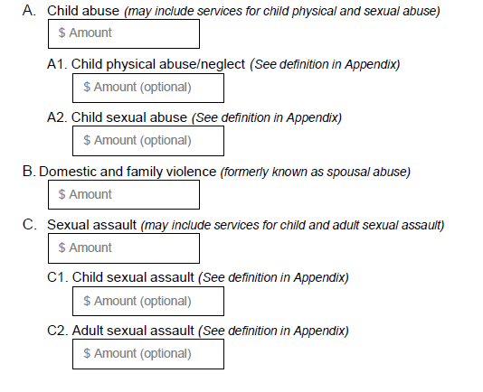
DIRECTIONS:
Complete/fill in every Blank
A. Child Abuse- Get this number from the chart above
A1 Child physical abuse/neglect
A2 Child sexual abuse
(Please report child sexual abuse or assault under section A.)
B. Domestic and Family Violence Get this number from the chart On question 4
C. Sexual Assault
C1 Child sexual assault (Do not use)
C2 Adult sexual assault (Do not use)

Slide 45
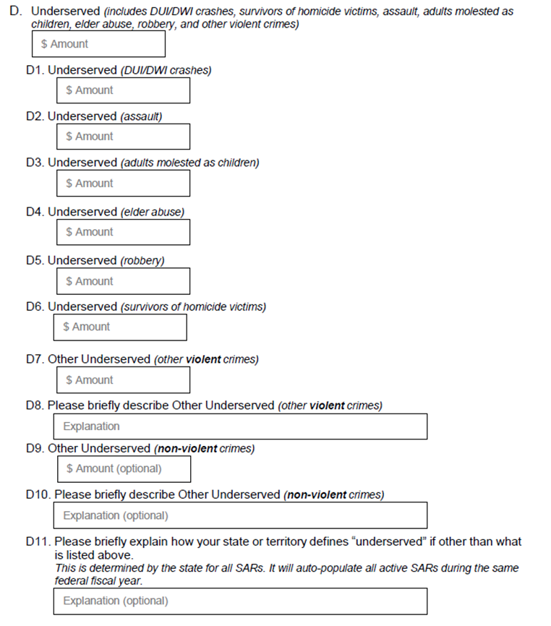
Directions (This is a continuation of the previous Section )
D. Underserved Get this number from the chart on question 4
D1. Underserved (DUI/DWI) This is a % of D.
D2 . Underserved (assault) This is a % of D.
D3 . Underserved (adults molested as children) This is a % of D.
D4 . Underserved (elder abuse) This is a % of D.
D5. Underserved (robbery) This is a % of D.
D6. Underserved (survivors of homicide victims) This is a % of D.
D7. Underserved (other violent crimes) This is a % of D.
D8. Please briefly describe Other Underserved (other violent crimes)
D9. Other Underserved (non-violent crimes)
D10. Please briefly describe other Underserved (non-violent crimes)
D11. Not required to answer.

Slide 46
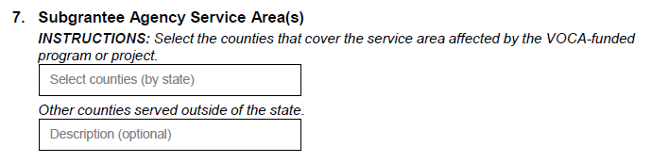
Directions
First Blank- Please list all the counties that you provide service to as described in your application
Second Blank- Please list all the counties served outside of the state.

Slide 47
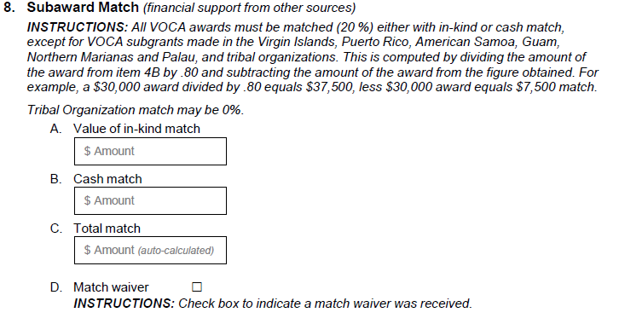
Directions
A. Value of in-kind match : The total of in-kind match should go here. (EX. Donations)
B. Cash Match : The total of cash match should go here. (EX. Salaries)
C. Total Match : This should be the total of A and B.
(A +B=C)
(Use the formula to Award Amount * 20/80 to get the total. If C is not equal to or greater then the amount, then you do not have enough match.)
D. Match waiver : (DO NOT CHECK THIS BOX)

Slide 48
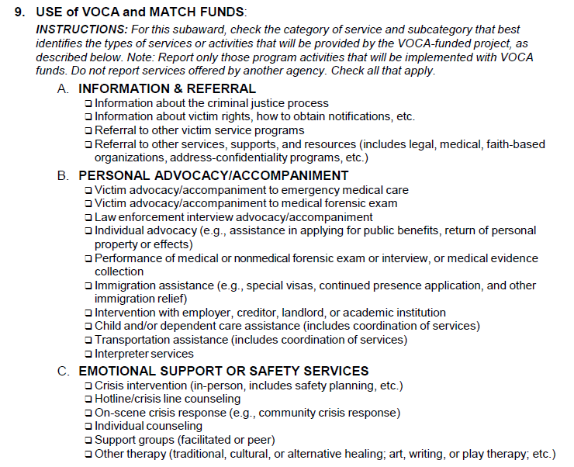
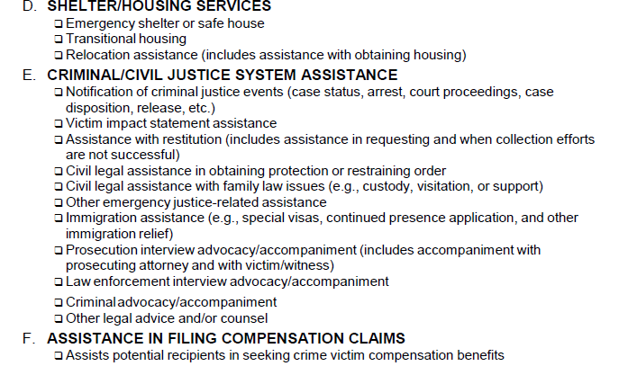
Directions
In this section there are 6 sections A, B, C, D, E, and F. For each section check the box by the name of the services that your organization provides using VOCA Funds. That will include the federal award and match Funds. If your organization provides other services that are listed but are not VOCA funded to provide that service, then do not check the box.

Slide 49
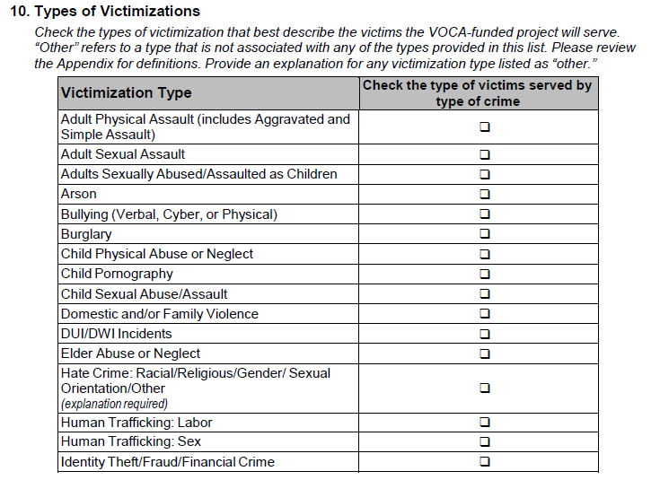
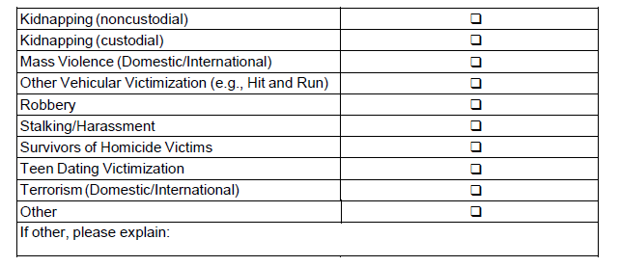
Directions
In this section there is a list of victimizations, check the box(s) that best describe the victims that the VOCA-funded project serve. There will be an Appendix with definitions on pages 10-13. The check list has an other option this refers to a type of victimization that is not associated with any of the other types listed.

Slide 50
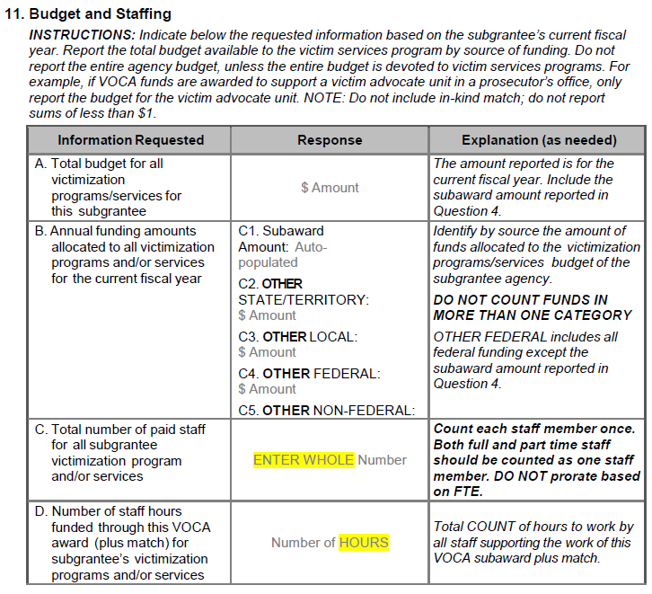
Directions
C1 Is the amount of the award
C2 Other State/Territory : money that is provided from the state that is provided with state funds.
C3 Other Local : is funds provided from the community such as fundraisers etc.
C4 Other Federal : includes all federal funding except the subaward amount reported in Question 4.
C5 Other Nonfederal : This is funding from foundation etc.
C. Third Row: count all employees that are payed from the VOCA award or the match funds as one employee regardless of full time or part time.
D. Fourth Row: count the total number of hours for the year that all the employees in C will work.

Slide 51
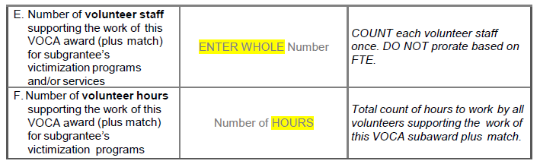
Directions (This is a continuation of the Chart from the previous Slide)
E Fifth Row count all Volunteer Staff that are payed from the VOCA award or the match funds as one employee regardless of full time or part time.
F Sixth Row count the total number of hours for the year that all the Volunteer Staff.

Slide 52
Monitoring
DFA-IGS is required to conduct on-site monitoring visits for at least 50% of its subgrantees each year.
A subgrantee that is in the first year of its funded program will also have an on-site monitoring visit.
The purpose of the visit is to ensure compliance with the applicable statutes, program guidelines, fiscal accountability, and other subgrant agreement terms and conditions.

Slide 53
Monitoring
Date and Time will be scheduled with the organization.
Pre-Visit Monitoring tool will be e-mailed to subgrantee to complete.
Grant Analyst will complete a Report of Findings.
Any areas of Deficiency will be identified.
Subgrantee will provide a Corrective Action Plan.

Slide 54
Important Due Dates
Monthly Reimbursement Request – Due the 15th of each month by 11:59 p.m. (Submitted through IGSConnect)
Quarterly Goals & Objectives Reports – January 15th, April 15th, July 15th, & October 15th by 11:59 p.m. (E-mailed to Grant Analyst)
Quarterly Performance Reports – January 15th, April 15th, July 15th, & October 15th by 11:59 p.m. (Submitted through IGSConnect)
Annual Inventory Report – May 31st by 11:59 p.m. (Submitted through IGSConnect)
Annual Report – October 31st by 11:59 p.m. (Submitted through IGSConnect)
SAR Reports – Beginning October 31st and Ending October 31st . (E-mailed to Grant Analyst) VOCA FUNDED SUBRECEPIENTS ONLY!!!
Yearly Audit - (E-mailed to Grant Analyst)

Slide 55
VJA Staff Contact Information
Brian Lawson 501-682-5266 Program Manager
Brian.lawson@dfa.arkansas.gov
Margaret Pace 501-682-5021 Grants Coordinator
Margaret.pace@dfa.arkansas.gov
Harold Clayton 501-682-4723 Grants Coordinator
Harold.clayton@dfa.arkansas.gov
Jonathon Barriere 501-682-5150 Grants Analyst
Jonathon.Barriere@dfa.arkansas.gov
Sandra Johnson 501-683-1238 Grants Analyst
Sandra.Johnson@dfa.arkansas.gov

Slide 56
DON’T FORGET TO DO THE SURVEY BELOW.
https://www.surveymonkey.com/r/GVP23YH

Slide 57

QUESTIONS

