Slide 1

Victim Assistance Grants RFP Technical Assistance Workshop

Slide 2
Housekeeping
Please silence your cell phones
Feel free to ask questions
Restrooms
No food

Slide 3
Who is VJA?
The Victim Justice and Assistance (VJA) projects are managed by the Office of Intergovernmental Services (IGS) within the Arkansas Department of Finance & Administration. VJA manages 205 grants throughout Arkansas.
VJA Mission Statement
  The Victim Justice and Assistance project is dedicated to achieving the goals of the VOCA, STOP, & FVPSA Grant projects to see improved community coordination, criminal justice, and the physical, emotional, and financial restoration of crime victims. It is dedicated to building constructive partnerships with subgrant recipients as it provides programmatic and financial oversight of subgrant agreements with focus on project outcomes and accountability.

Slide 4
Funding Sources
Family Violence Prevention Services Act (FVPSA)
Services, Training, Officers, Prosecution (STOP)/Violence Against Women (VAWA)
Victims of Crime Act (VOCA)

Slide 5





Eligible Organizations
Eligible organizations include those organizations whose sole purpose is to serve crime victims. This includes public and non-profit organizations that have components which offer services to crime victims. Eligible organizations include:

Slide 6

FVPSA
The purpose of FVPSA is to assist in the establishment, maintenance and expansion of projects that:
  Prevent incidences of family violence, domestic violence, and dating violence;
  Provide immediate shelter, supportive services, and access to community-based projects for victims of family violence, domestic violence, or dating violence, and their dependents; and
  Provide specialized services for children exposed to family violence, domestic violence or dating violence including victims who are members of underserved communities.
  MATCH REQUIREMENT: The organization must contribute no less than 20% of the federal portion of the project as match.

Slide 7
FVPSA Allowable/Unallowable Expenses
ALLOWABLE SERVICES/ACTIVITIES (Not all inclusive)
  Emergency Shelter Activities
  Outreach and Prevention Services
  Employment Training
  Legal Advocacy
  Transportation
  Children’s Counseling and Support Services
UNALLOWABLE SERVICES/ACTIVITIES (Not all inclusive)
  Lobbying
  Research and Studies
  Capital Expenses
  Compensation for Victims of Crime
  Fundraising
  Medical Care

Slide 8

STOP/VAWA
The primary purpose of STOP/VAWA is to develop and strengthen the criminal justice system's response to violence against women and to support and enhance services for victims.
The STOP/VAWA project encourages victim service providers, prosecutors, law enforcement, and the courts to implement coordinated multidisciplinary approaches to address domestic violence, sexual assault, and stalking.
MATCH REQUIREMENT: The State of Arkansas requires recipients to provide a 28% match of the Federal portion of the project. If an applicant is funded under the victim services provision or is from the state’s sexual assault and domestic violence coalitions, the match requirement is not required.

Slide 9
STOP Allowable/Unallowable Expenses
ALLOWABLE SERVICES/ACTIVITIES (Not all inclusive)
  Victim Services
  Prosecutorial Services
  Law Enforcement
  Data Collection Systems
  Training
  Legal Advocacy
UNALLOWABLE SERVICES/ACTIVITIES (Not all inclusive)
  Lobbying
  Prevention Activities
  Projects which may compromise victim safety and undermine offender accountability
  Fundraising
  Purchase of real property
  Renovation projects
  Construction

Slide 10

VOCA
The primary purpose of VOCA is to support the provision of services to victims of crime. Services include, but are not limited to: crisis intervention, emergency shelter, criminal justice advocacy and counseling. VOCA funds are used only for direct services to victims.
MATCH REQUIREMENT: For previously funded organizations, the organization must contribute no less than 20% of the federal portion of the project.
  Match Formula: (Federal Funds Requested x 20)/80 = Required Match
  Match will be waived for the 2023 – 2024 VOCA Grant period.

Slide 11
VOCA Allowable/Unallowable Expenses
ALLOWABLE SERVICES/ACTIVITIES (Not all inclusive)
  Crisis Intervention
  Hospital Accompaniment
  Mental Health & Tele-Health
  Emergency Food & Clothing
  Transitional Housing/Rapid Relocation
  Emergency Shelter
  Assistance with participation in criminal justice proceedings
UNALLOWABLE SERVICES/ACTIVITIES (Not all inclusive)
  Lobbying
  Research & Studies
  Active investigations & prosecution of criminal activities
  Fundraising
  Capital Expenses
  Medical Care
  Salaries & Expenses for Management
  Purchase of Vehicles

Slide 12
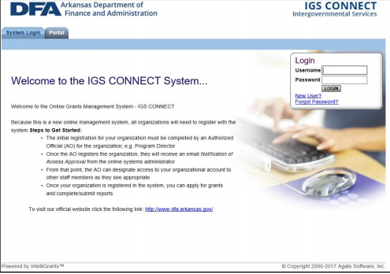
IGS Connect

Slide 13
Users of
IGS Connect
An organization’s authorized/highest ranking official (AO) will need to register with IGS Connect using the new user link found on the home page.
  A confirmation email will be sent to the provided email address once the request is approved.
  Request for new users are approved Monday – Friday during regular business hours.
  Organizations should set-up their IGS Connect account immediately to ensure ample time is available to complete the process.
  After an organization is granted access to IGS Connect, the authorized official can grant access to additional users from their organization under the Acting Authorized Official (AAO) role.

Slide 14
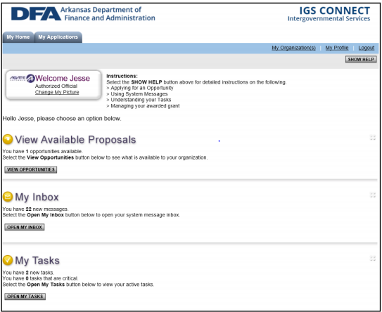
IGS Connect Homepage
Access to the Proposals is available through the IGS Connect Homepage under the “View Available Proposals” section.
Click on the “View Opportunities” tab to open proposals page.

Slide 15
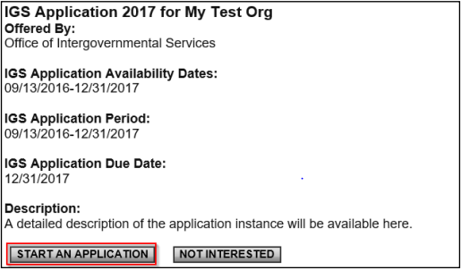
Initiating an Application
To begin an application, select the “Start an Application” tab.
  Selecting this tab will begin a new application and will only need to be selected once per application.
  If you will be submitting more than one application, you will need to repeat this step for each application you plan to submit.
  Only one VOCA application will be accepted.

Slide 16
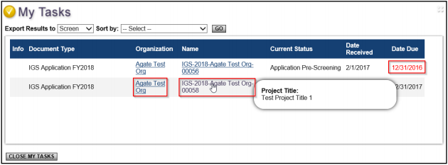
Accessing Application
After you have initiated an application, your application will be saved to your account.
The application will be accessible to you through the “My Tasks” tab found on the IGS Connect homepage.

Slide 17
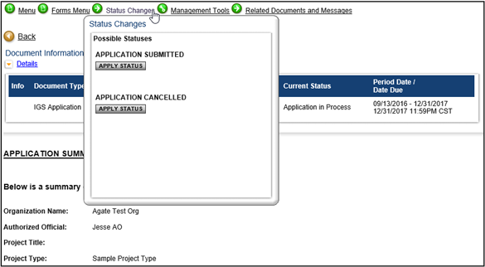
Submitting Application
After you have completed your application, you will need to change the status to “Application Submitted”.
Applications that have not had the status changed to submitted are not eligible to be reviewed.

Slide 18

Grant Application

Slide 19
Application Forms
Authorized Official/Highest Ranking Official Contact Information
  Provide contact information for the highest-ranking official in the organization.
  Project Summary
    Provides a snapshot of your proposed project.
    Attachments
    Form SF-424
    Project Policies & Procedures
    Financial Policies & Procedures

Slide 20
Project Narrative
Project Summary
  A brief description of your project. The “elevator speech” for your project.
  Needs Assessment (30 points)
    Why is the proposed project needed?
    List a maximum of 5 community-specific reasons why the project is needed.
    Include relevant local data to support the project.
  Applicant’s Capability (25 points)
    Brief history of your organization and its ability to carry out the proposed project.
  Population to be Served (15 points)
    Identify the population to be served by the project.
    Identify any underserved population that will be served by the project.

Slide 21
Project Narrative Continued
Project Activities (40 points)
  Identify all services or activities to be provided by the project.
  Describe best practices or evidence-based activities to be used with the project.
Collaboration (10 points)
  Describe how community partners will be involved with the project.
Evaluation Plan (10 points)
  Describe how you will measure the project’s success.
Sustainability Plan (20 points)
  How will your project continue to operate in the event of a loss of Federal funds.
  Sustainability Plan must be included with the project’s Special Conditions if the project is funded.

Slide 22

Goals & Objectives
Goals: broad statements that address a change in behavior that the project will address.
  Applicants can enter up to 5 separate goals for the project.
  Goals are limited to 150 characters
  Each Goal will have at least one objective and one measurement.
  Objectives: specific measurable statement that outline how the goal will be accomplished.
    Applicants can enter up to 3 separate objectives per goal.
    Objectives are limited to 300 characters.
    Each Objective will have a measurement.
    Measurement: detail how each objective will be obtained
      Measurements show how the objective will be proven successful (number of clients served), not how the data is collected (sign-in sheets).
      Measurements are limited to 300 characters.

Slide 23
Financial Overview
Provides a picture of your organization’s capability to properly manage Federal funds.
List all of your organization’s revenue sources and amounts that will allow the organization to operate during the proposed project’s fiscal year (October – September). This includes all grant funds (actual & anticipated) and non-grant funds.

Slide 24
Employee Detail Form
Must be completed for all employees that will have a role in carrying out the project whether supported by Federal funds or serve as Match for the project.
Pay Information: Include hourly rate of pay, hours devoted to the project, and a brief job description.
Mandated Benefits: Includes FICA, Worker’s Compensation, & State Unemployment Insurance (SUI).
  FICA: 7.65%
  Worker’s Compensation: maximum rate is 5%
  SUI: maximum rate is 3% of the first $7,000 of salary
  Employer Provided Benefits
    Health Insurance: maximum allowable amount for federal funds is $500/project staff member
    Retirement: maximum allowable rate is 15.32%

Slide 25
Project Budget & Budget Narrative
Should be reflective of what is outlined in the proposed project.
Should only include expenses that are allowable per the funding source.
Budget will include both Federal Funds request and, if required, Match funds.

Slide 26
Project Budget & Budget Narrative –
Budget Categories
Salary – information provided from Employee Detail Form.
Employer Mandated Benefits – FICA, Worker’s Compensation, & SUI. Information provided from Employee Detail Form.
Employer Provided Benefits – various insurances & Retirement. Information provided from Employee Detail Form.
Maintenance & Operations (M&O) – Costs associated with carrying out the project that are not Salary related. M&O expenses can include, but are not limited to, rent, building depreciation, utilities, supplies, equipment purchases less than $5,000, etc.

Slide 27
Project Budget & Budget Narrative –
Budget Categories Continued
Professional/Contract Services – any service agreements needed to carryout the project.
Travel/Training – Travel associated with the project.
Travel/Mileage line item is reimbursed at $.42/mile.
Trainings must be in-line with the project and have IGS prior approval before attending. Should include all costs associated with attending the training.
Other Expenses – expenses that cannot be placed into any other category. Includes request for Indirect Costs.

Slide 28
Match
Match can be non-Federal grants or Cash or In-Kind donations and should be used for the proposed project.
Volunteers can be used to help deliver the service provided by the proposed project.
Volunteers are a good source of in-kind match and the DFA-IGS established hourly rate for volunteers is $25.43/hour.

Slide 29
Application Review and Determination Process
REVIEW
Applications are subject to several reviews. These reviews assist DFA-IGS in making funding recommendations which enhance the State of Arkansas’ service delivery system to victims of crime. The process for review and determination of a subgrant award is as follows:
ELIGIBILITY REVIEW: Applications will be reviewed to ensure that minimum eligibility requirements have been met. If the organization or its proposal does not meet the minimum eligibility requirements, the applicant will be notified that it is not eligible to receive funding.
ADVISORY COMMITTEE: Pursuant to state law, DFA-IGS’ advisory board will be provided an opportunity to review and comment on all applications.
REVIEW COMMITTEES: All eligible applications will be reviewed and scored based on application content by three separate review teams – 1) VJA Staff, 2) DFA-IGS Advisory Committee, and 3) an independent review committee. Member of each review team will review assigned application utilizing the VJA Grant Scoring Rubric.

Slide 30
Application Review and Determination Process Continued
RANKING OF APPLICATION: After all applications have been scored by each review committee, an average score for the application will be determined by adding each score and dividing it by three. Once the average score for each application is determined, the applications will be ranked based on the average score, with #1 being the application with the highest average score.
AWARD DETERMINATION: Applications will be awarded based on the ranking of the application and allowable expenses per the funding source. Applications will be selected for funding until the budget amount of funds are allocated. At this point, no additional proposals will be funded, regardless of ranking.
ADMINISTRATIVE REVIEW: The DFA-IGS Administration will make a final determination on which applications will be funded based on recommendations from DFA-IGS staff, the Advisory Board, and the Review Committee.
DETERMINATION NOTIFICATION
Upon completion of the application review process, DFA-IGS will send notice to all applicants indicating if their application(s) has been approved and at what level of support. Applications approved for funding will be finalized in a grant award document to the sub-grantee.

Slide 31
Victim Justice Assistance Grant Scoring Rubric
Application Total Score: 200 points

Slide 32
Section 1- Programmatic Review

Slide 33
Needs Assessment (30 points)
Strong (30-21 points) | Moderate (20-11 points) | Weak (10-0 points)
• Need for project is clearly defined • A maximum of 5 community-specific reasons for the project and local supportive data is provided. • Population to be served, current services, & obstacles faced by population identified. • Local statistical data used to support need. | • Need for project adequately defined. • Community-specific reasons for the project provided, but no local supportive data provided. • Population to be served , current services, & obstacles faced by population provided, but lacking clear connection to project need. • Statistical data provided, but is not local to the identified service area. | • Need for project not clearly defined or missing • Community-specific reasons for the project are not provided. • Population to be served, current services, & obstacles faced by population not clearly defined or missing. • No statistical data provided.

Slide 34
Applicant Capacity (25 points)
Strong (25-18 points) | Moderate (17-10 points) | Weak (9-0 points)
• Applicant provided a concise historical background of agency. • Community partners and their role in the project identified. • Description of services provided by applicant provided. • Capacity of staff identified and shows capability to carry out project. | • Historical background of agency provided. • Community partners identified, but role in project not defined. • Services provided by applicant provided, but missing description. • Staff identified, but capability to carry out project to discussed. | • No historical background of agency provided. • No community partners identified. • No mention of services provided by applicant. • No mention of project staff.

Slide 35
Population to be Served (15 points)
Strong (15-11 points) | Moderate (10-5 points) | Weak (4-0 points)
• Population to be served by project clearly identified & includes types of victims to be served (domestic violence, sexual assault, etc.). • Underserved populations to be served identified & percentage of underserved victims to be served provided. • Local statistical data provided to highlight underserved populations. | • Population to be served & types of victims to be served are somewhat identified. • Underserved populations not clearly identified & percentage of underserved victims to be served is not provided • Statistical data about population provided by not at the local level. | • Population to be served not identified. • No statistical data about population to be served provided. • Underserved population not identified

Slide 36
Project Activities (40 points)
Strong (40-31 points) | Moderate (30-20 points) | Weak (19-0 points)
• Activities to address the need are clearly & specifically identified • Benefit for victims is clearly expressed. • Activities are clearly reflected in budget. | •Activities to address the need are listed. • Benefit for victims discussed. • Most activities are reflected in the budget. | • Activities to address the need are not specific to the need of victims. • Benefit to the victim not discussed. • Activities are not clearly reflected in the budget.

Slide 37
Collaboration (40 points)
Strong (10-8 points) | Moderate (7-5 points) | Weak (4-0 points)
• Specific community partners are identified. • Clear description of how agency will work with other community partners to carry out project's activities and avoid duplication of services. | • Community partners identified. • No clear description of how agency will work with other community partners. • Unclear if project activities will duplicate already existing services in the community. | • Community partners are not identified. • No plan to work with community partners provided. • Activities appear to duplicate services already provided in targeted community.

Slide 38
Goals & Objectives (10 points)
Strong (10-8 points) | Moderate (7-5 points) | Weak (4-0 points)
• Goals & Objectives are clearly reflective of the project's activities. • Objectives are S.M.A.R.T (Specific, Measurable, Attainable, Relevant, & Timely). • Measurements detail how objectives will be met. | • Goals & Objectives are reflective of the project's activities. • Objectives are missing one or more of the S.M.A.R.T (Specific, Measurable, Attainable, Relevant, & Timely) descriptions. • Measurements do not detail how objective will be met. | • Goals & Objectives are not reflective of project's activities. • Objectives are not S.M.A.R.T (Specific, Measurable, Attainable, Relevant, & Timely). •Measurements not provided.

Slide 39
Evaluation Plan (10 points)
Strong (10-8 points) | Moderate (7-5 points) | Weak (4-0 points)
• A clear plan to determine the impact of the project is described. • Evaluation method(s) is/are clearly identified and is/are consistent with the type of data to be gathered. | • An evaluation plan is provided. • Evaluation method(s) identified. | • No clear evaluation plan provided. • No evaluation methods are identified.

Slide 40
Section 2 - Financial Review

Slide 41
Budget (40 points)
Strong (40-31 points) | Moderate (30-20 points) | Weak (19-0 points)
• Budget narrative provided and calculations are correct. • Budget clearly reflects activities discussed in Project Activities. • Expenses are allowable based on funding source and Request for Application.. | • Budget narrative provided for most expenses and calculations have no major errors. • Budget narrative reflects most activities discussed in Project Activities. • Most expenses are allowable based on funding source and Request for Application. Minor questions concerning some line items. | • Budget narrative calculations are incorrect or not included. • Budget is not reflective of what was discussed in Project Activities. • Expenses are not allowed based on funding source and Request for Applicaton.

Slide 42
Sustainability Plan (20 points)
Strong (20-15 points) | Moderate (14-9 points) | Weak (8-0 points)
• Applicant has a clear plan for how program services will continue without federal funding. • Applicant has discussed its ability to raise funds outside of federal funding. | • Applicant discusses plan for continuing program services without federal funding. • Applicant's ability to raise funds outside of federal funding is limited. | • Applicant does not demonstrate that it has a plan for how program services will continue without federal funds. • Applicant has not discussed its ability to raise funds outside of federal funding.

Slide 43
Important Dates
April 17 – May 19
Written questions can be submitted by email to the project Manager and answers will be posted on FAQ section of the DFA-IGS website.
May 26– 11:59pm
APPLICATION SUBMISSION DEADLINE IN IGS CONNECT
May 29- July 30
Proposal Review & Selection
July 31 – September 15
Consultations, Appeals, & Award Acceptance
October 1
Project Start Date

Slide 44

Questions

