Slide 1
Residential Substance Abuse Treatment Program (RSAT)
Technical Assistance Workshop
Kimberly Orr, Grants Coordinator

Slide 2
OFFICE OF INTERGOVERNMENTAL SERVICES
PASS THROUGH ENITITY
PROVIDE TECHNICAL ASSISTANCE
CONDUCT ONSITE VISITS
BUILD PARTNERSHIPS

Slide 3
AGENDA
Eligibility
Goals and Objectives
Requirements
Application Process
Questions and Answers

Slide 4
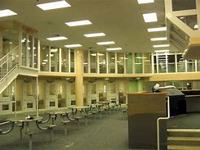
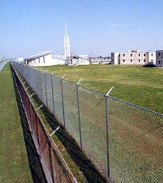
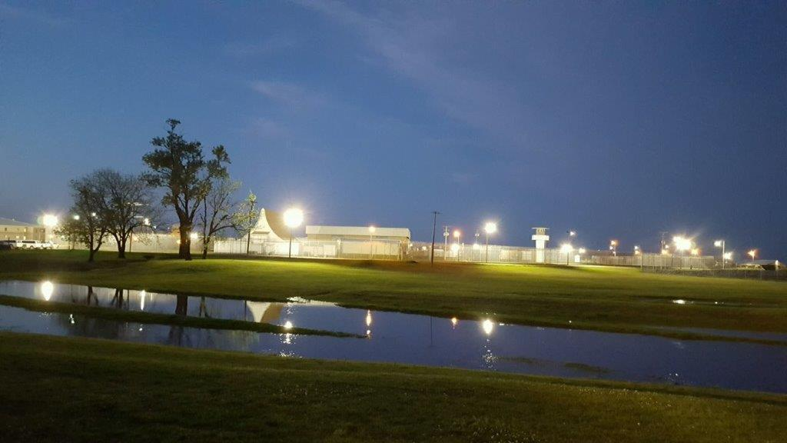
Who’s Eligible?
JAILS
PRISIONS
DETENTION CENTER
JUVENILE FACILITY

Slide 5
RSAT Goals & Objectives
Provide
Provide substance abuse treatment for incarcerated inmates.
Prepare
Prepare individuals for re-entry into their communities.
Assist
Assist with providing community-based treatment and after-care services.

Slide 6
Requirements
Separation from the general correctional population.
Require urinalysis and/or reliable drug and alcohol testing.
Periodic and Random Testing
Ensure individuals with after-care services upon re-entry.
After-care services coordination:
Parole supervision programs
Half-way house programs
Transportation

Slide 7
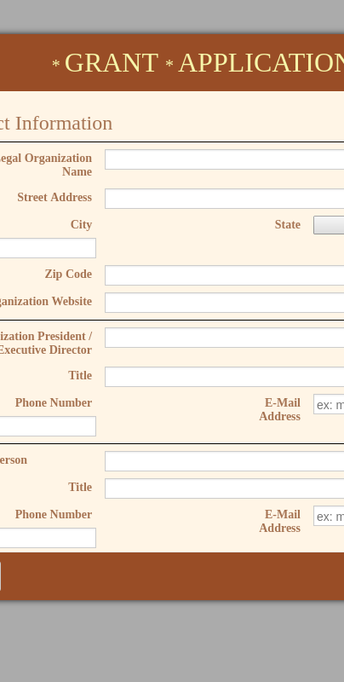
Let’s Apply
Cover Page (Grant Application)
Abstract
Commitment to RSAT Goals and Objectives
Standard 424

Slide 8
ADDITIONAL FORMS Residential Substance Abuse Treatment For State Prisoners (RSAT) Program | Department of Finance and Administration (arkansas.gov)

Slide 9
PROGRAM NARRATIVES
PROBLEM STATEMENT
PROGRAM DESCRIPTION
(INCLUDE EVIDENCE-BASED/BEST PRACTICES)
DESCRIPTION OF SPECIFIC GOALS AND OBJECTIVES
DECRIPTION OF IMPLEMENTATION
DESCRIPTION OF EVALUATION

Slide 10
Let’s Budget

Slide 11
ALLOWED
SALARIES
MANDATED BENEFITS
EMPLOYER BENEFITS
MAINTENANCE
EQUIPMENT
TRAVEL

Slide 12
LET’S MATCH
Match can be in-kind or cash.
What does that mean?

Slide 13
DISALLOWED
LOBBYING
FUNDRAISING
RENOVATION PROJECTS
CONSTRUCTION
PURCHASE OF REAL PROPERTY

Slide 14
Evaluation Process
Applicants will be rated from 1-5 in the following categories:
Problem Statement
Program Description
Description of Specific Goals and Objectives
Description of Implementation
Description of Evaluation
Plans for Sustainability

Slide 15
RATING RANGE
Outstanding | Comprehensive Description Relevant Examples Strong Understanding of the RSAT Project | 5
Very Good | Significant Description Response not entirely comprehensive Sound Understanding of the RSAT Project | 4
Acceptable | Basic Response Significant details not included Minimal understanding of the RSAT Project | 3
Marginal | Insufficient information Incomplete answers to sections Major gaps in information provided | 1-2

Slide 16
Deadline Date
All completed applications must be submitted to IGS.APPLICATIONS@DFA.ARKANSAS.GOV by 4:30 P.M., Tuesday, July 30, 2024.

Slide 17
IGS CONTACT INFORMATION
DFA-IGS Staff:
Leesa Freasier, Grants Manager
Leesa.Freasier@dfa.Arkansas.gov
(501) 682-5022
Kimberly Orr, Grants Coordinator
Kimberly.Orr@dfa.Arkansas.gov
(501) 682-5110
Richard Wyllia, Grants Analyst
Richard.Wyllia@dfa.Arkansas.gov
(501) 682-5254
Email: IGS.JAG@dfa.arkansas.gov
Phone: (501) 683-0927

Slide 19
Thank you

